Slide 1
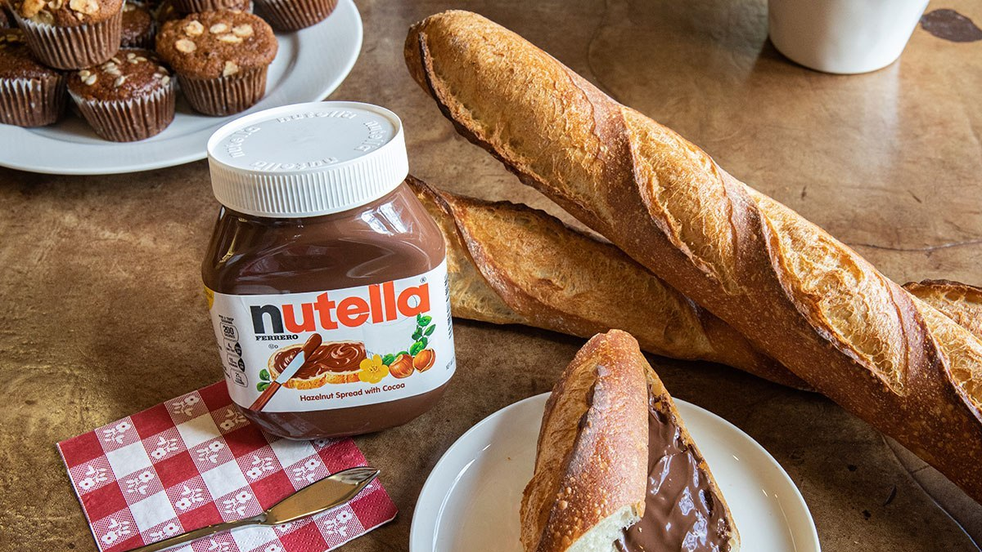
Nutella
By Alyssa
Notes:
Good morning my Ms Farah and my online friends, today ill be talking about chocolate. More specifically, Nutella. I’m sure we are well aware of Nutella and would probably bought one if not taste Nutella before. So you may ask, since Nutella is already so successful, why am I still talking about it?

Slide 2
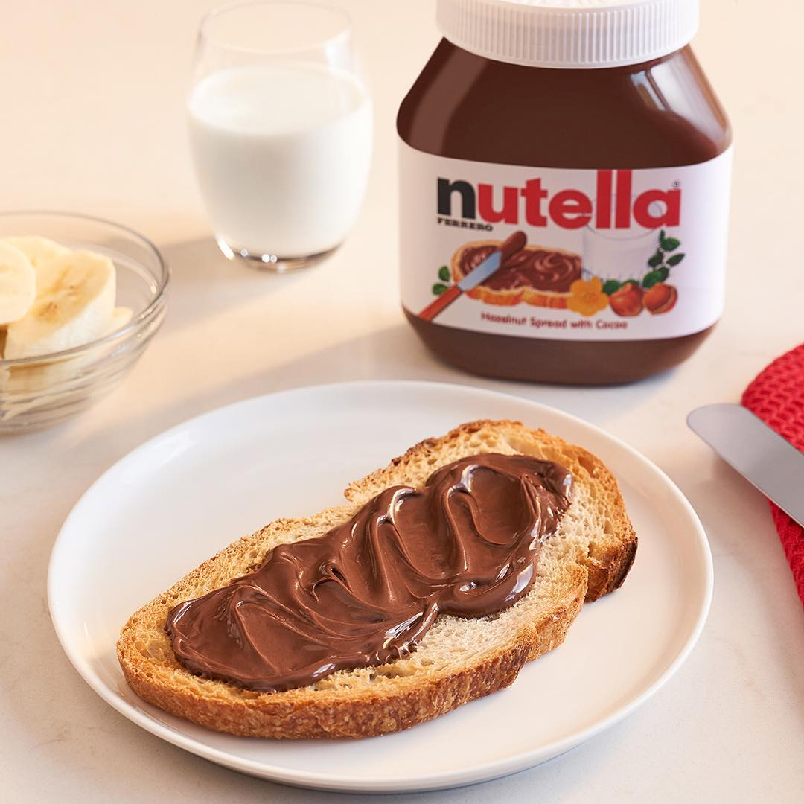
Problem Statement
Nutella was faced with decreasing household penetration.
This is because there was a lack of understanding around how Nutella could be used beyond spreading the product on toast.
Notes:
This is because, a problem has arisen.
Nutella has been facing a decline within the household penetration and low repeat buyers. This means that lesser people are purchasing Nutella and even lesser are repeatedly purchasing it.
This is because there is a lack of understanding around how Nutella could be used beyond spreading the product on toast. So, in other words, the first thing people think of Nutella, is that it’s a spread for bread, and ONLY bread. But that is not true. Let me tell you why…

Slide 3
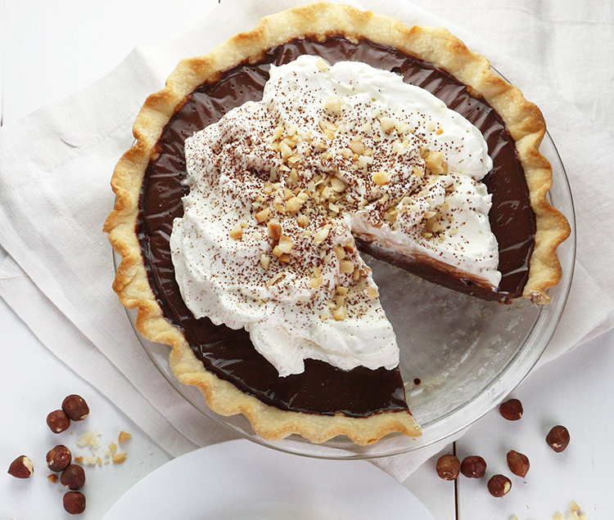
Advertising Objectives
Push the boundaries of being just a spread for bread and show that Nutella is a very versatile snack that is fun to make and yummy to eat.
Notes:
In this campaign, the advertising objective is to push the boundaries of Nutella being just a spread for bread. Instead, introduce Nutella as a versatile snack that is fun to make and yummy to eat.

Slide 4


Urban or Suburban
Mid-High income group
Target Audience
Mason
Lucy
Mike
32-45 years old Mom
Notes:
The target audience would be similar to Nutella’s original target group.
This would be Mothers who are around 32-45 yrs old. Who is married and have young/ teenage kids.
She is most probably a housewife that has a busy lifestyle. Despite being busy, she is a family-oriented person who values’ her children’s happiness and is
32-45 years old
A mom who was young/teenage children
Housewife
Busy lifestyle
Value’s her children’s happiness
Family-oriented

Slide 5
Urban or Suburban
Target Audience
Mid-High income group
Busy life
Lucy
Lucy who is 35 years old, is a mother of two kids, 13 and 9 years old respectively.
Lucy is a housewife who takes care of cooking, cleaning and taking care of the children. Her life is not easy.
Each morning, she is troubled of what breakfast to prepare for her kids. She cares for her kids so much that she wants to give them the best food that makes them happy and that requires minimal preparation time.
Mason
Lucy
Mike
32-45 years old Mom
Housewife
Family-oriented
Notes:
The target audience would be similar to Nutella’s original target group.
This would be Mothers who are around 32-45 yrs old. Who is married and have young/ teenage kids.
She is most probably a housewife that has a busy lifestyle. Despite being busy, she is a family-oriented person who values’ her children’s happiness and is
32-45 years old
A mom who was young/teenage children
Housewife
Busy lifestyle
Value’s her children’s happiness
Family-oriented

Slide 6
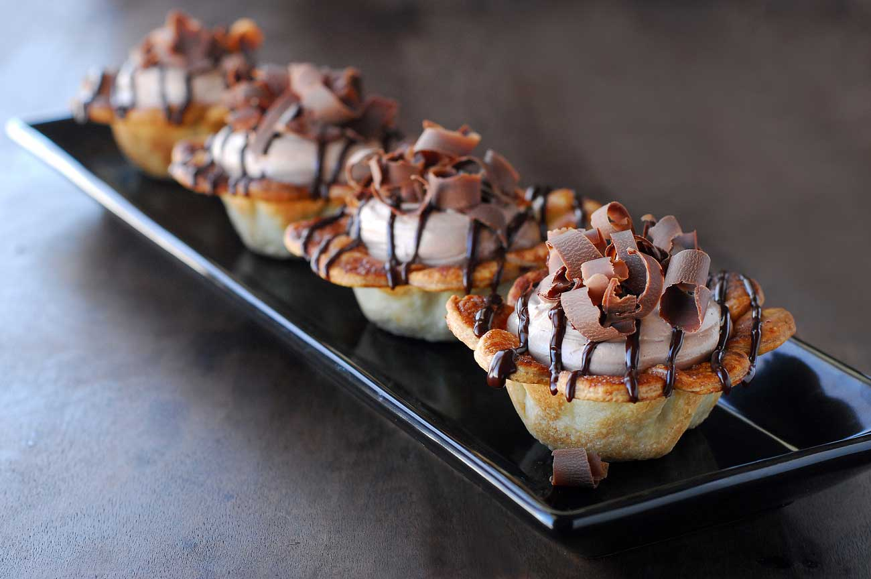
You can make countless different desserts using Nutella. It goes very well rolled in crepes.
Consumer Insights
I can't believe this is advertised as a breakfast food. I use it to frost brownies. Its CLEARLY a chocolate dessert
Notes:
These two insights both highlight that Nutella can do more than what was showed in the ads, which is to be spread on bread.

Slide 7
You can make countless different desserts using Nutella. It goes very well rolled in crepes.
Consumer Insights
I can't believe this is advertised as a breakfast food. I use it to frost brownies. Its CLEARLY a chocolate dessert
Notes:
These two insights both highlight that Nutella can do more than what was showed in the ads, which is to be spread on bread.

Slide 8
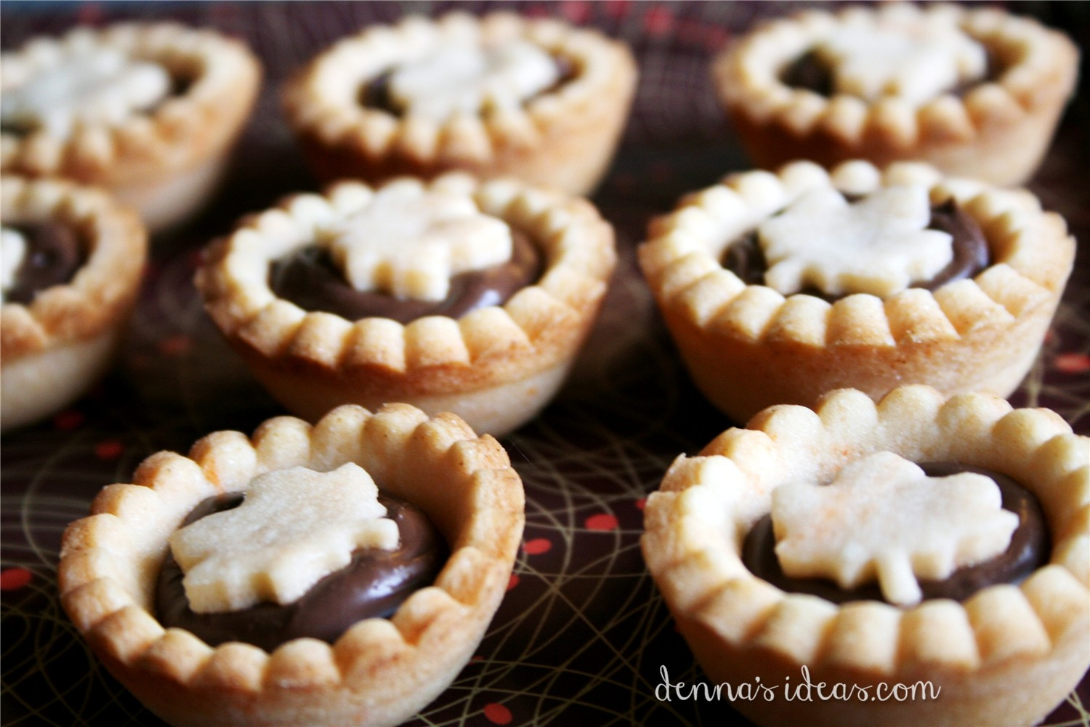
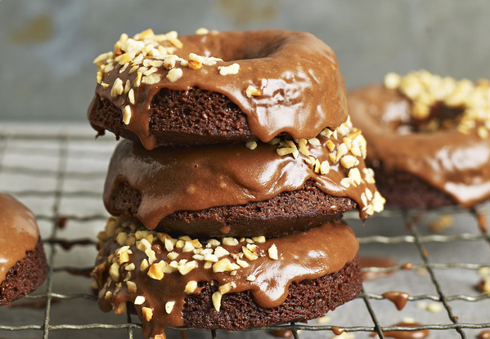

Do more with Nutella
Notes:
As u can see in the pictures. Nutella is used like as a filling for tarts, as a dip for donuts, as a coating for ice cream.

Slide 9




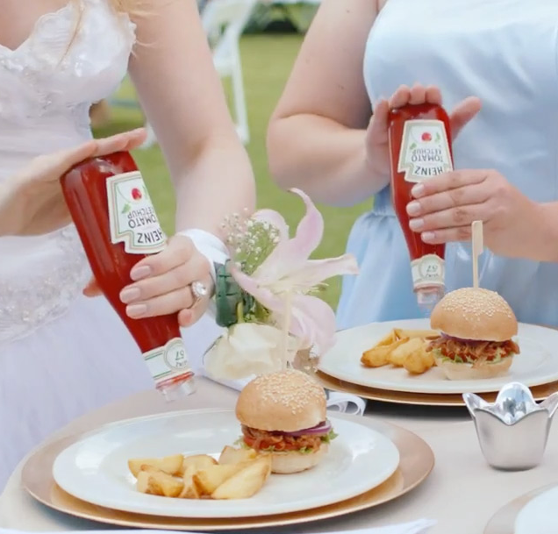
Tone & Manner
Notes:
Whoopee (wild excitement or joy)
Fun
Intimate{Show more interaction with the mom and child}
Light-hearted/Warm: Similar to Heinz ads (https://www.youtube.com/watch?v=OCGPQUKo9Ws)

Slide 10
Tone & Manner
Whoopee
Notes:
Whoopee (wild excitement or joy)
Fun
Intimate {Show more interaction with the mom and child}
Light-hearted/Warm: Similar to Heinz ads (https://www.youtube.com/watch?v=OCGPQUKo9Ws)

Slide 11
Tone & Manner
Whoopee
Fun
Notes:
Whoopee (wild excitement or joy)
Fun
Intimate {Show more interaction with the mom and child}
Light-hearted/Warm: Similar to Heinz ads (https://www.youtube.com/watch?v=OCGPQUKo9Ws)

Slide 12
Tone & Manner
Whoopee
Fun
Intimate
Notes:
Whoopee (wild excitement or joy)
Fun
Intimate {Show more interaction with the mom and child}
Light-hearted/Warm: Similar to Heinz ads (https://www.youtube.com/watch?v=OCGPQUKo9Ws)

Slide 13
Tone & Manner
Whoopee
Fun
Intimate
Warm
Notes:
Whoopee (wild excitement or joy)
Fun
Intimate {Show more interaction with the mom and child}
Light-hearted/Warm: Similar to Heinz ads (https://www.youtube.com/watch?v=OCGPQUKo9Ws)

Slide 14
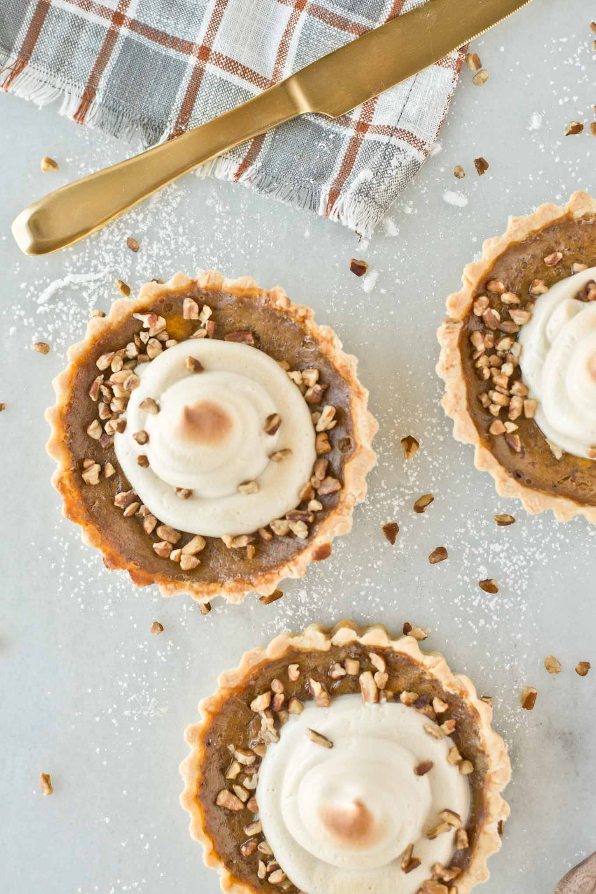
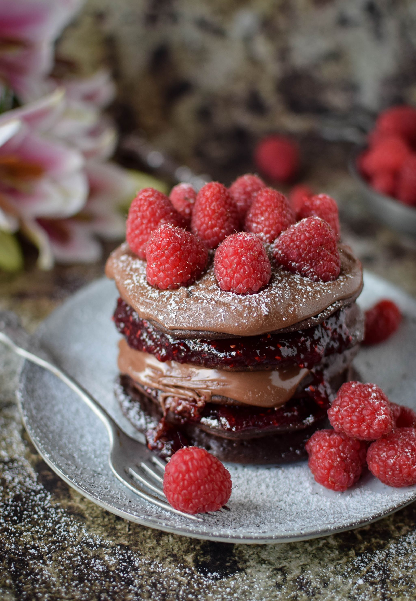

Support
Notes:
Pictures speak bigger than words
So many recipes that Nutella can explore on.

Slide 15
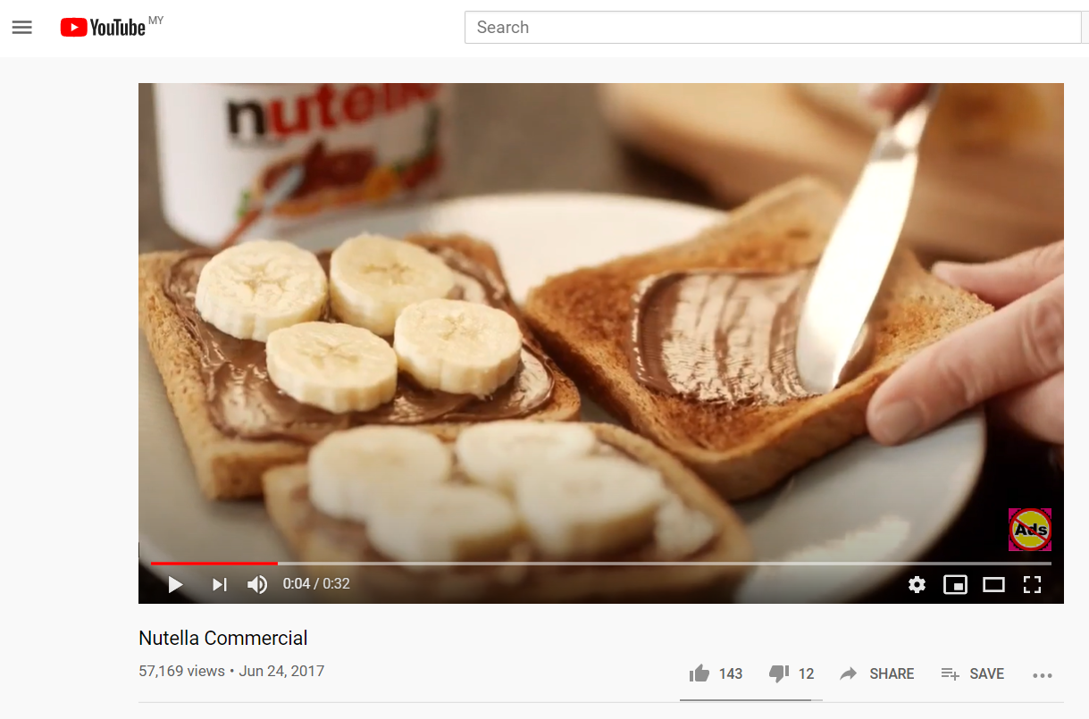


Slide 16
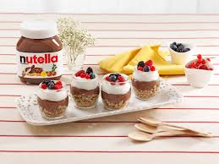
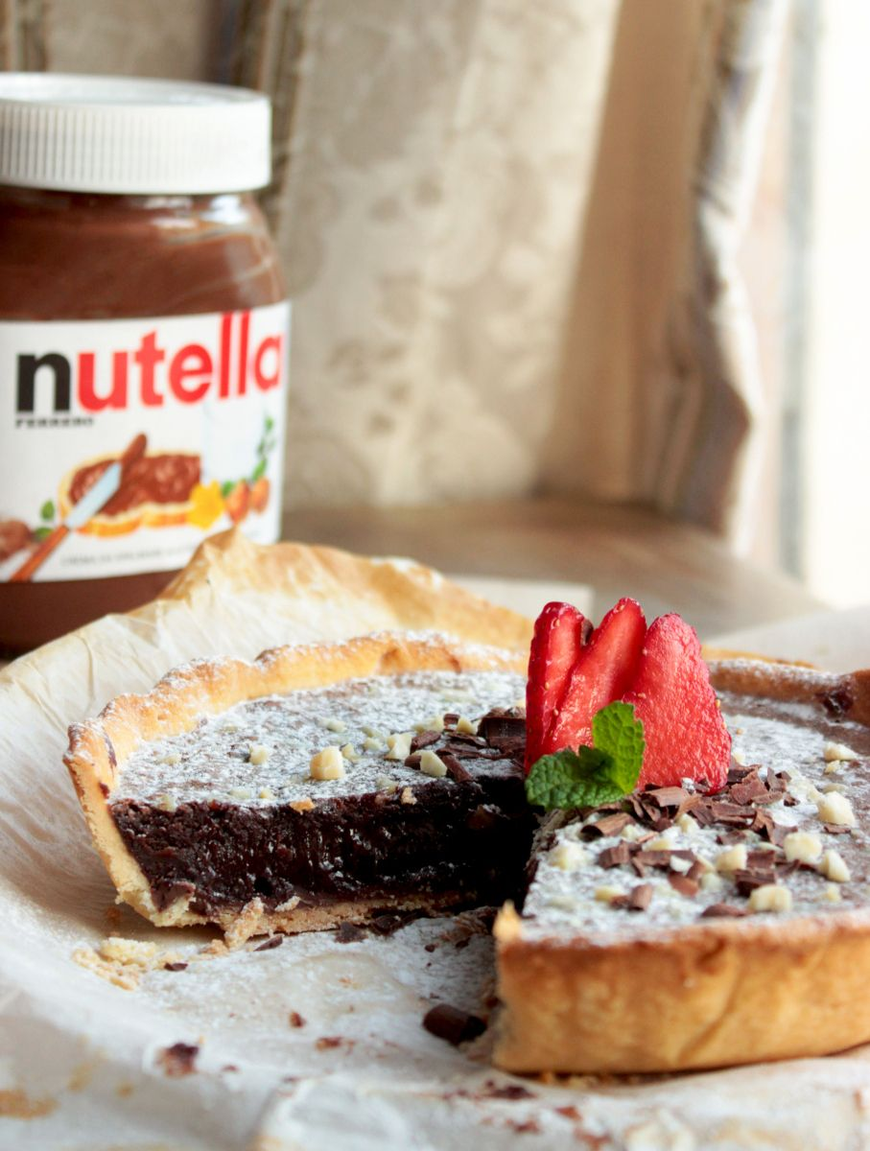
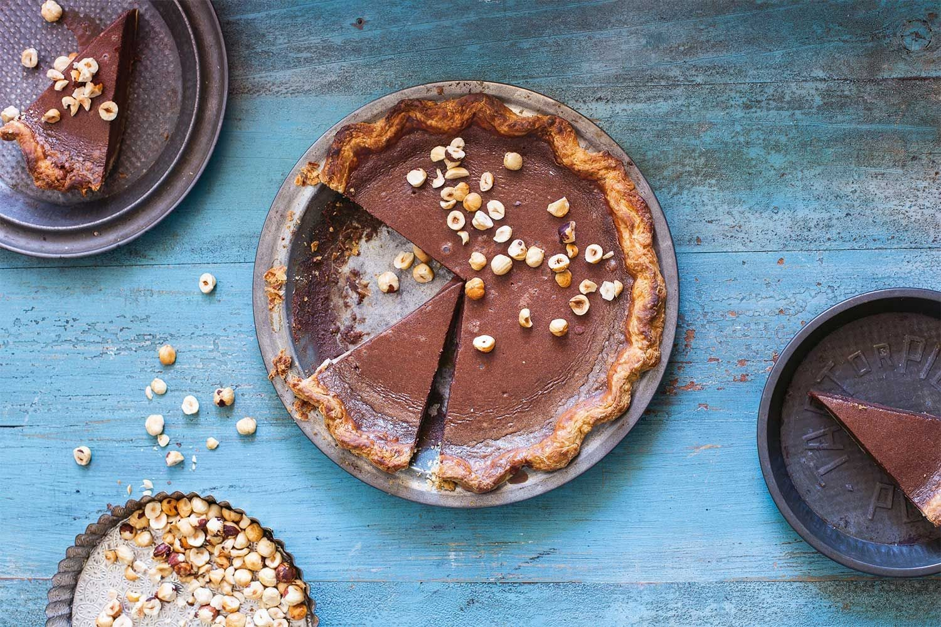

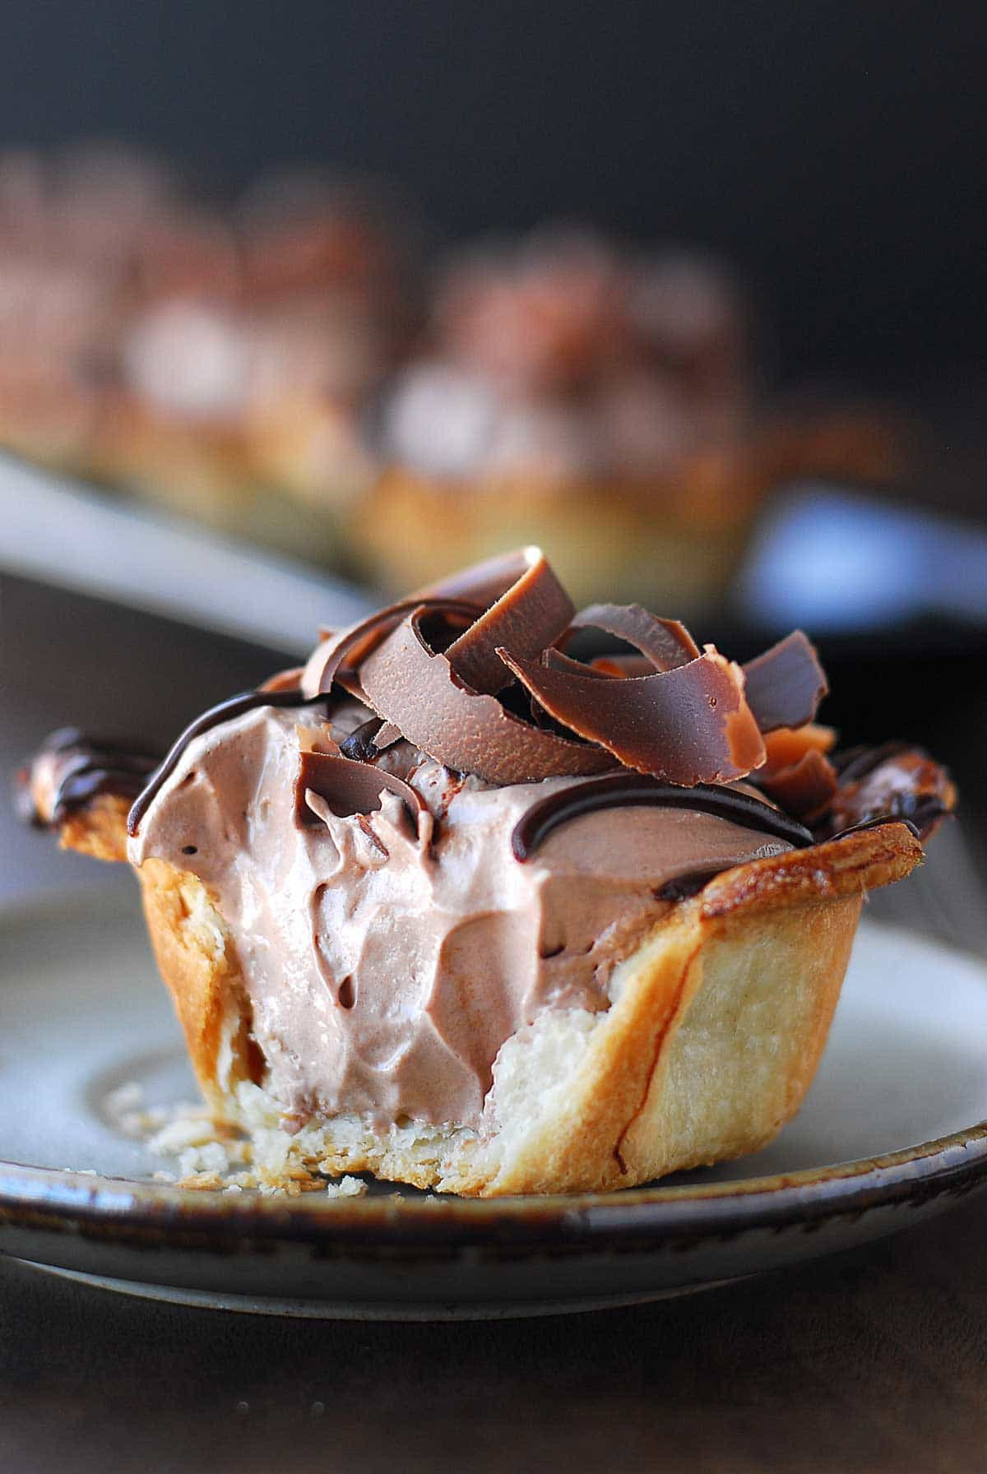
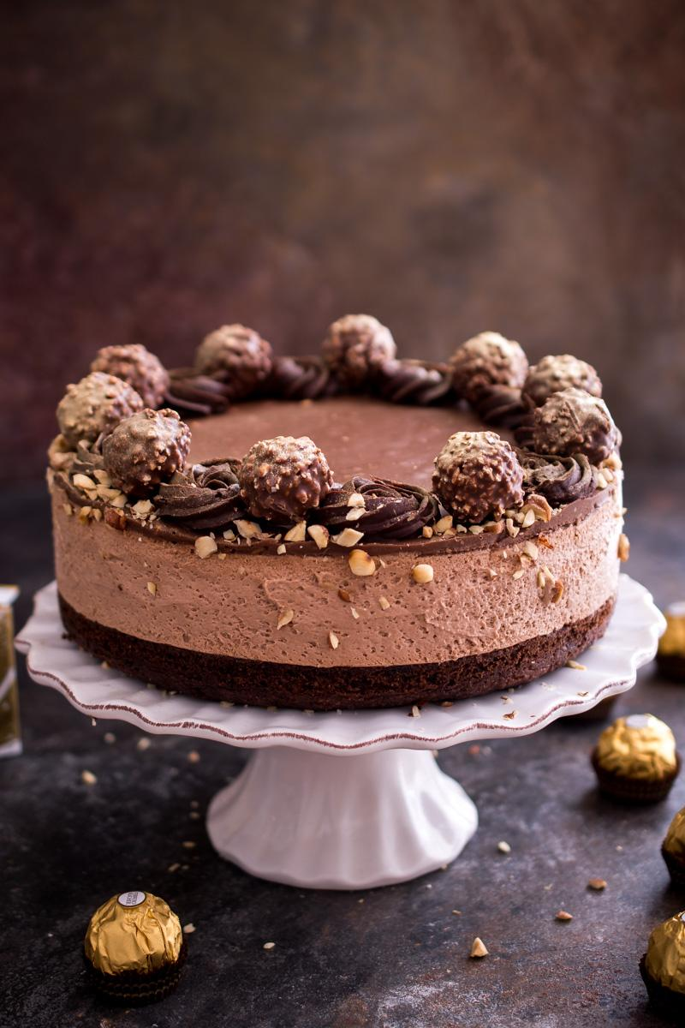
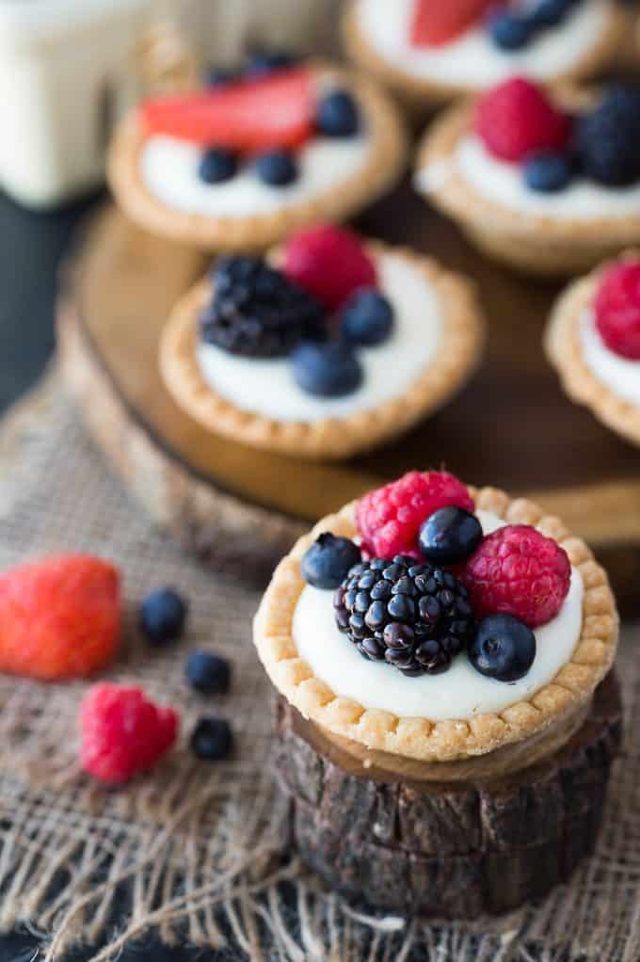
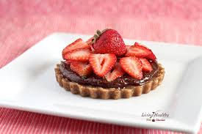
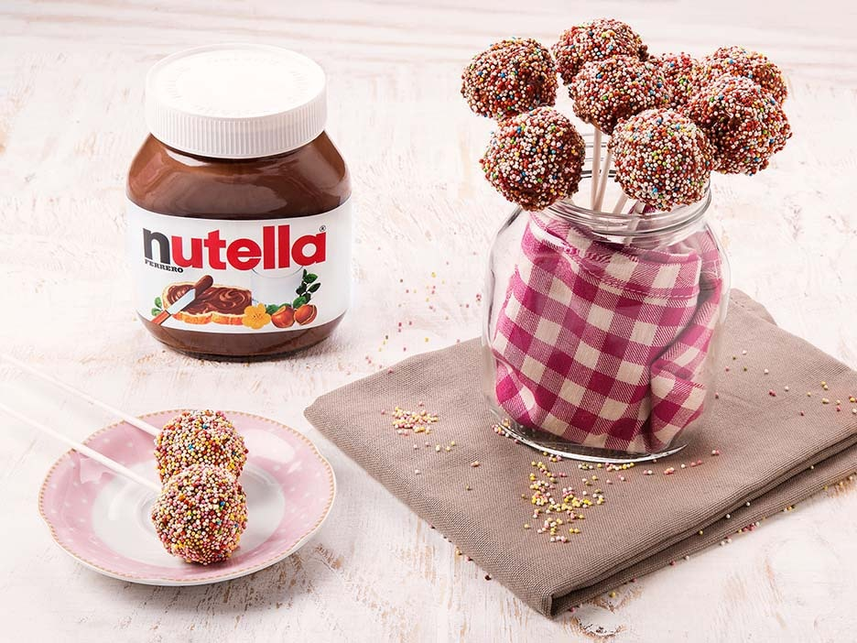
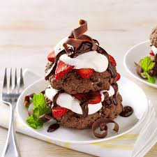
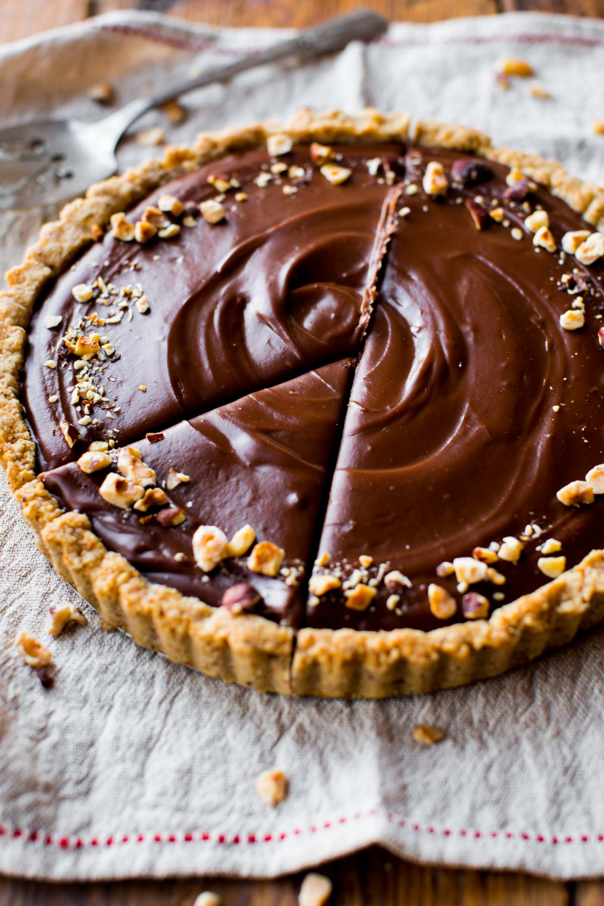

Slide 17
The New-tella Way
(the New way of eating Nutella)
Notes:
So the next time you run out of ideas eating Nutella, hit me u[ and watch out for my campaign! XDXD

Slide 18
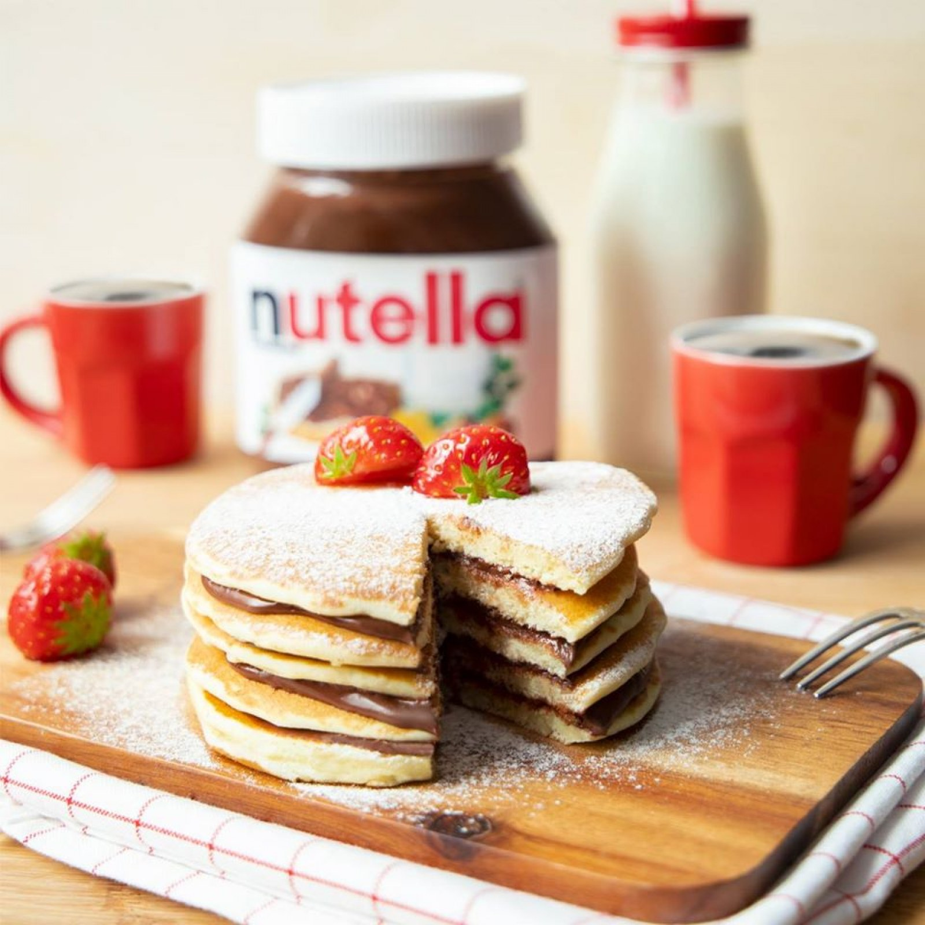
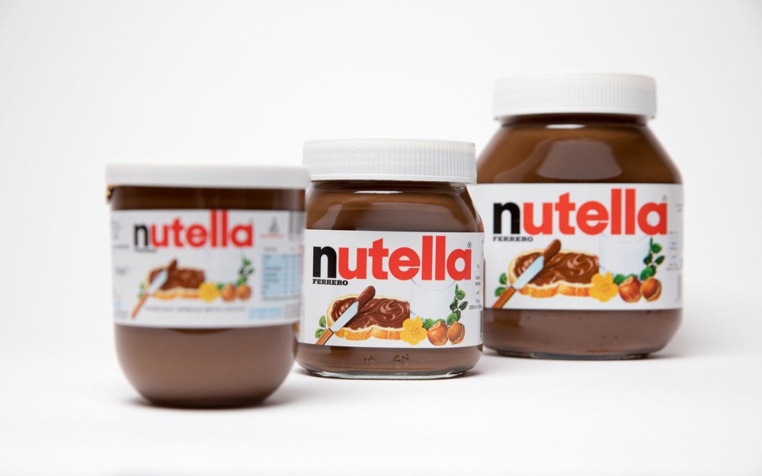


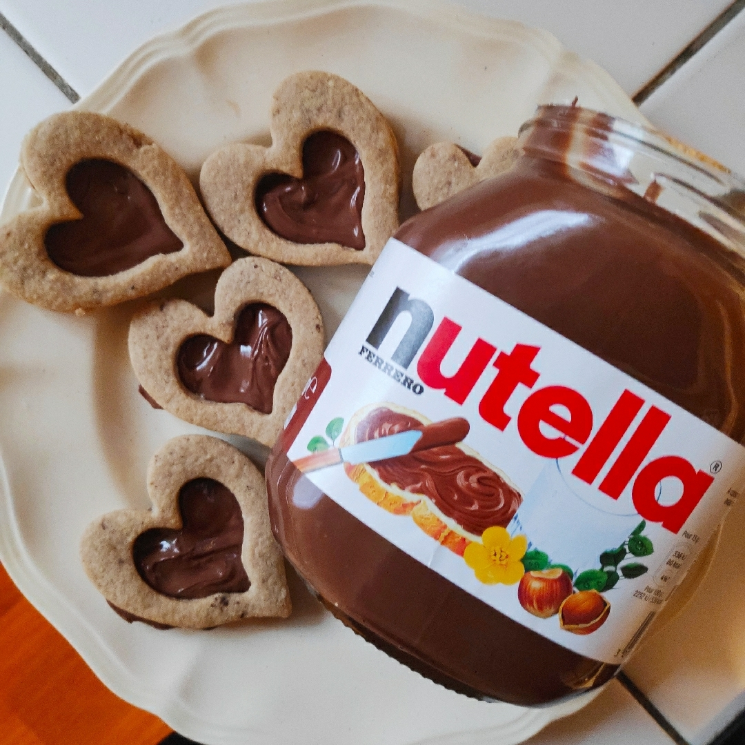


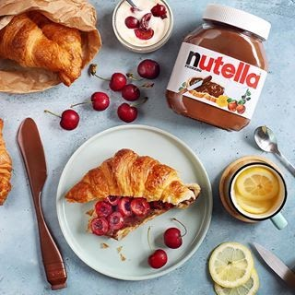
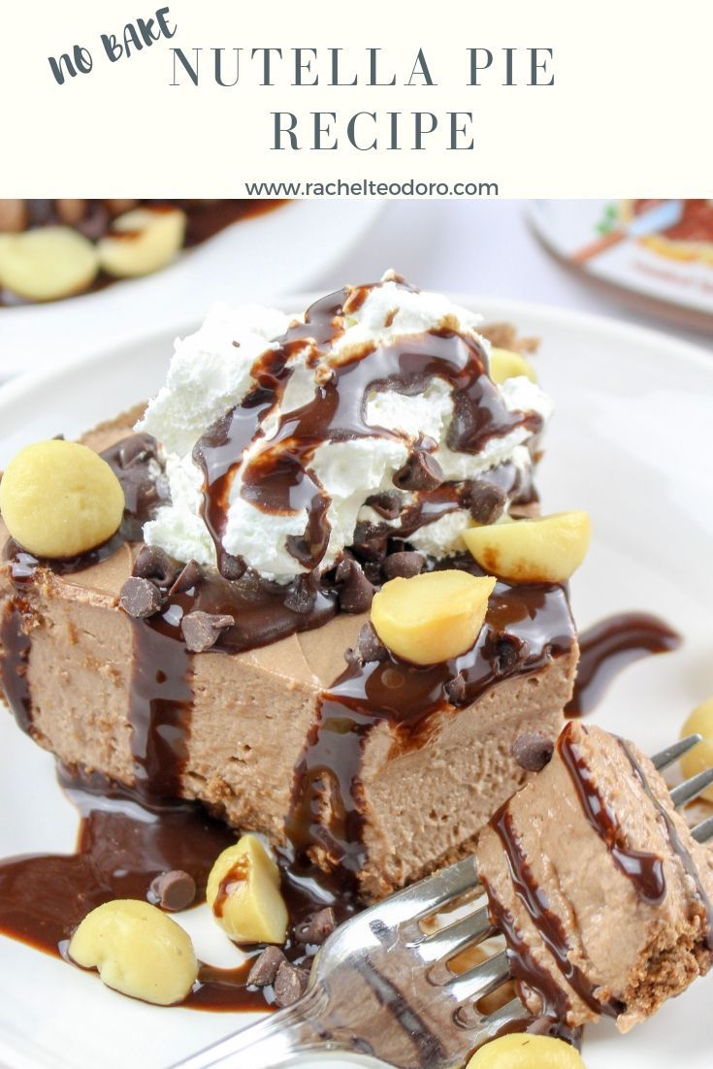
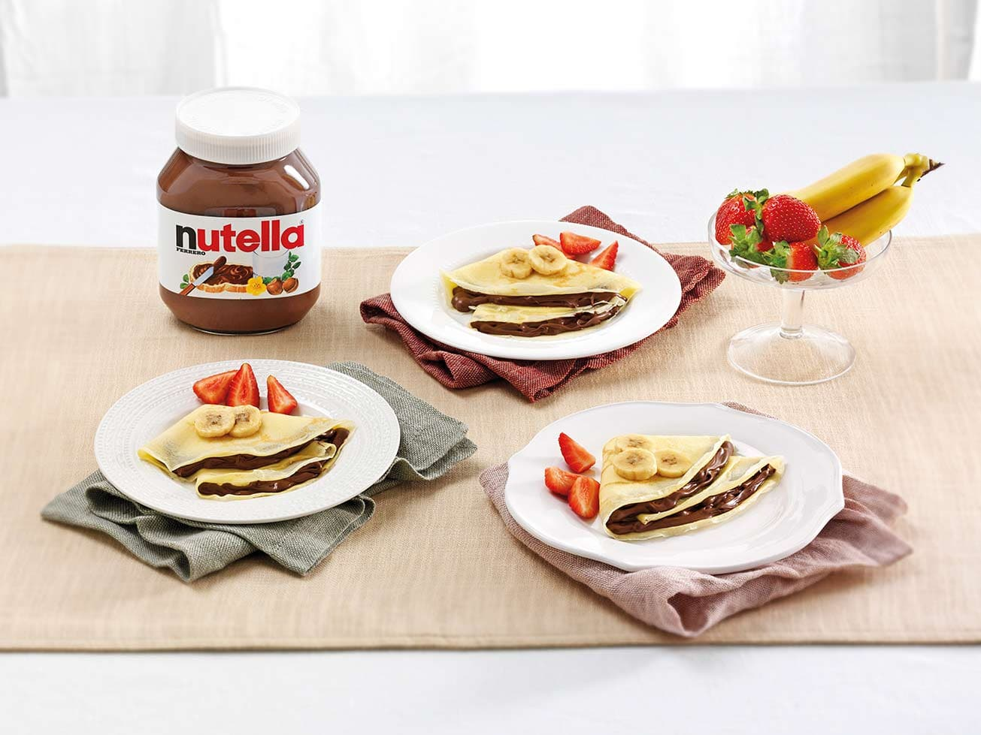
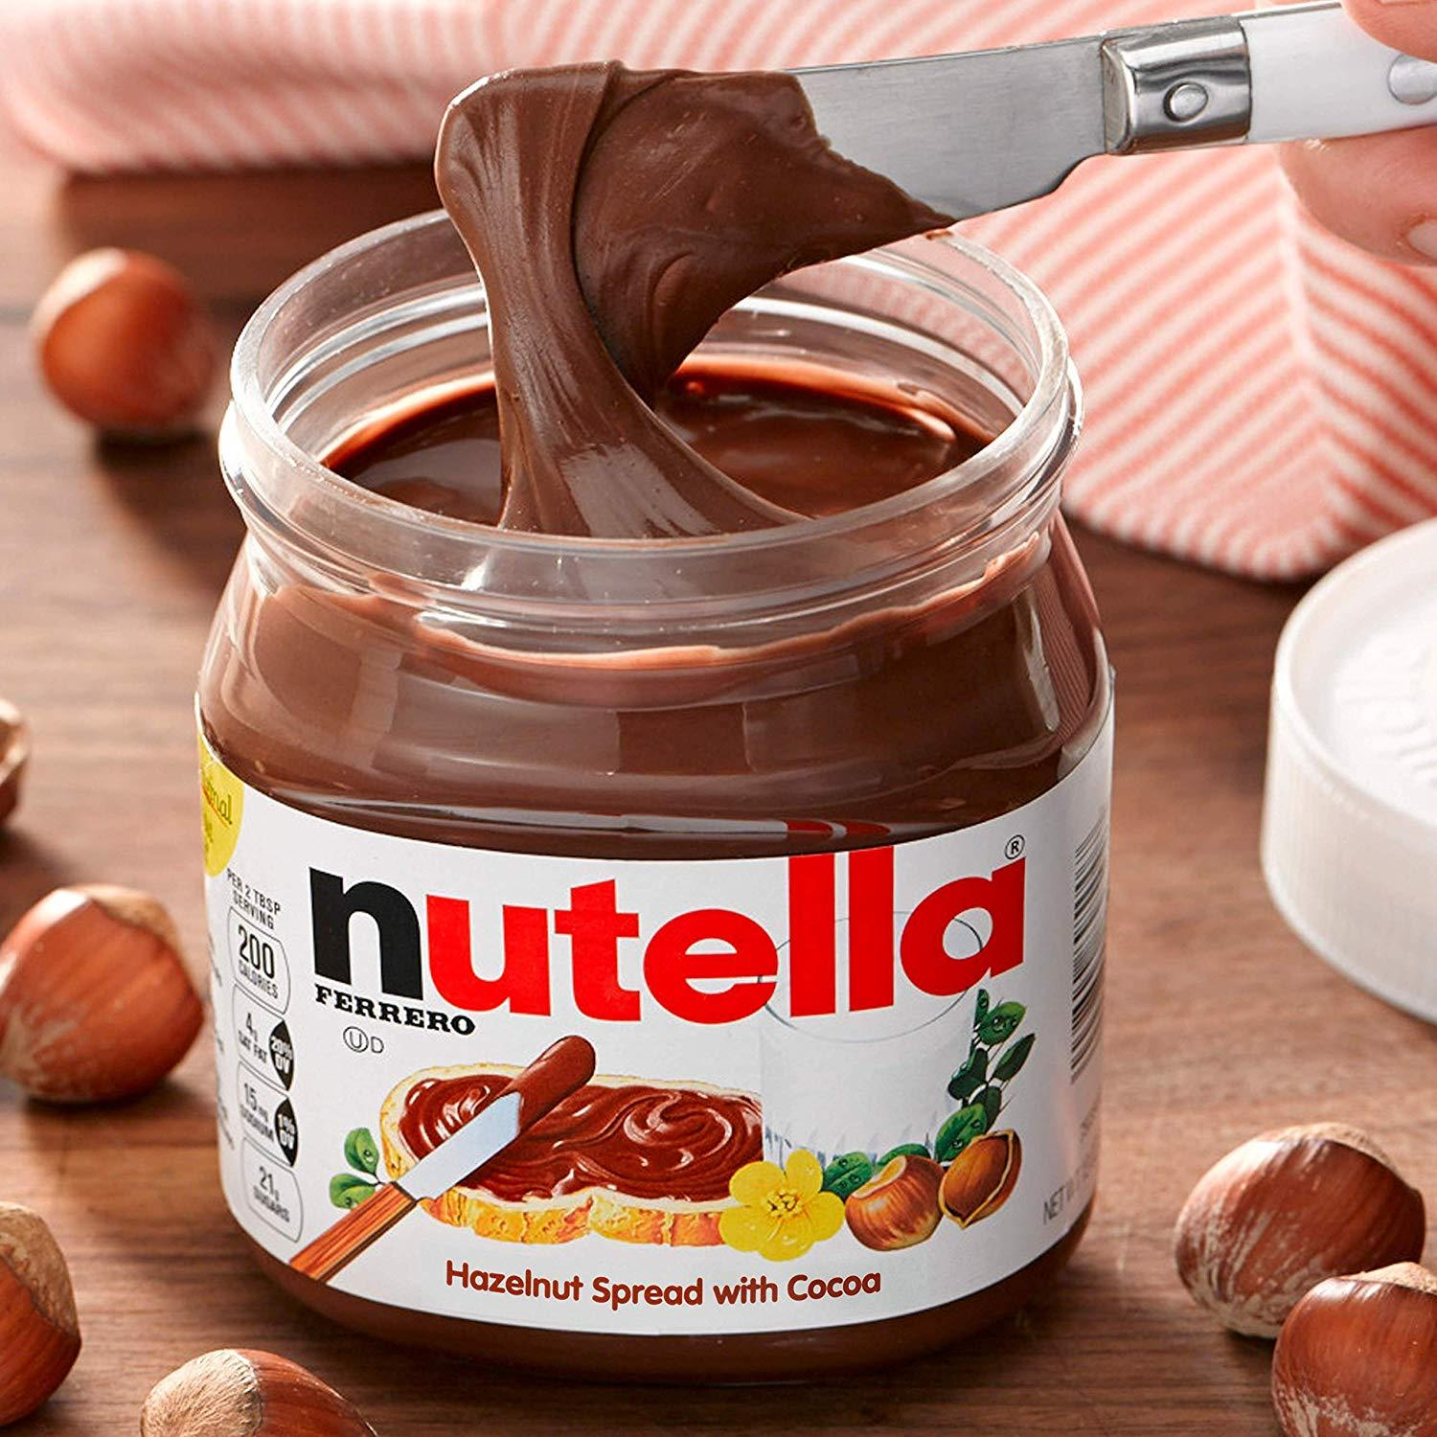
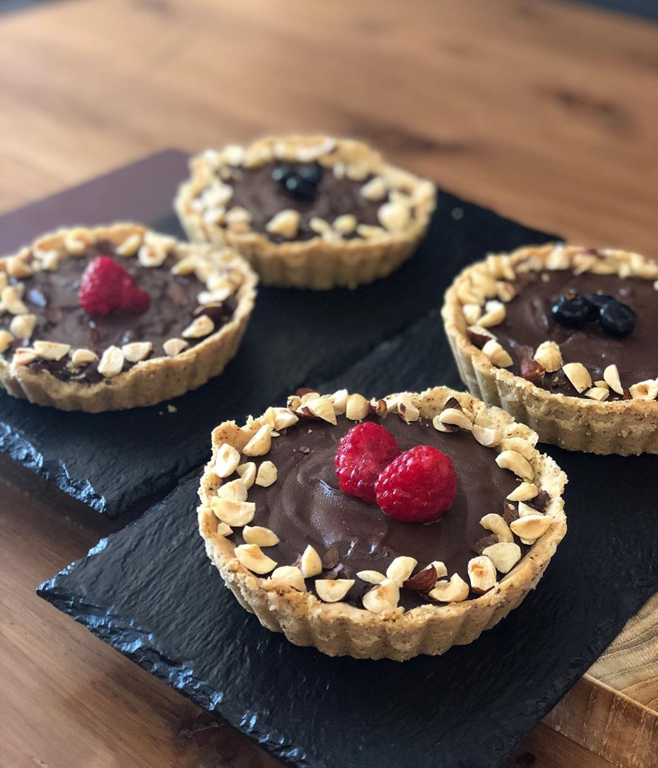
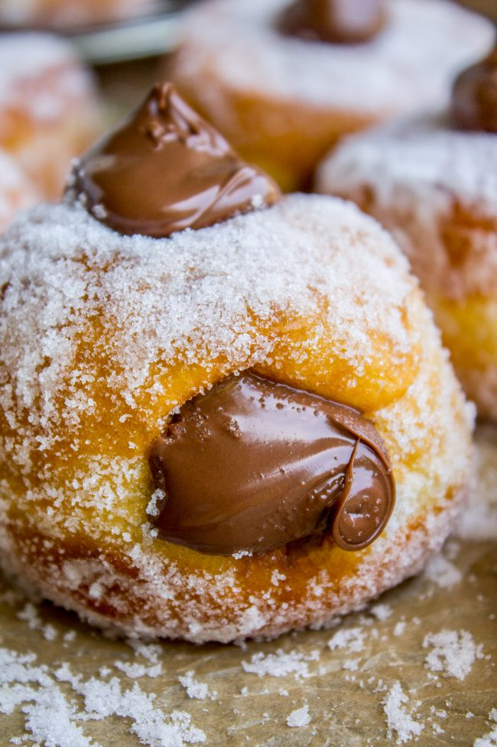
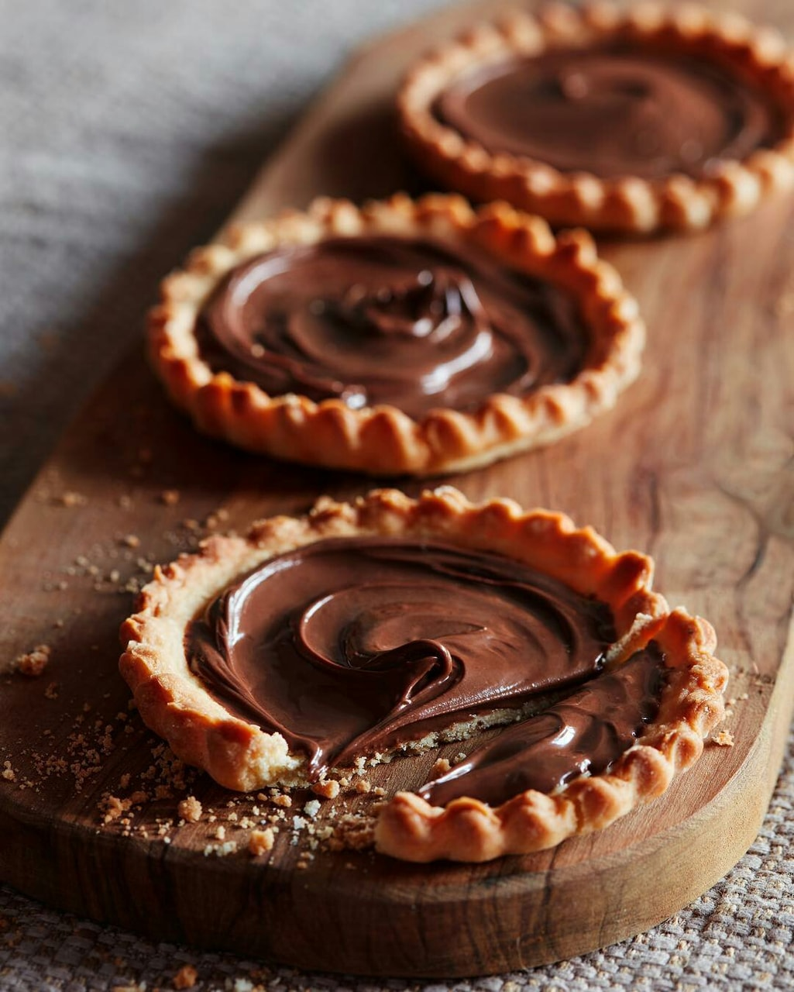
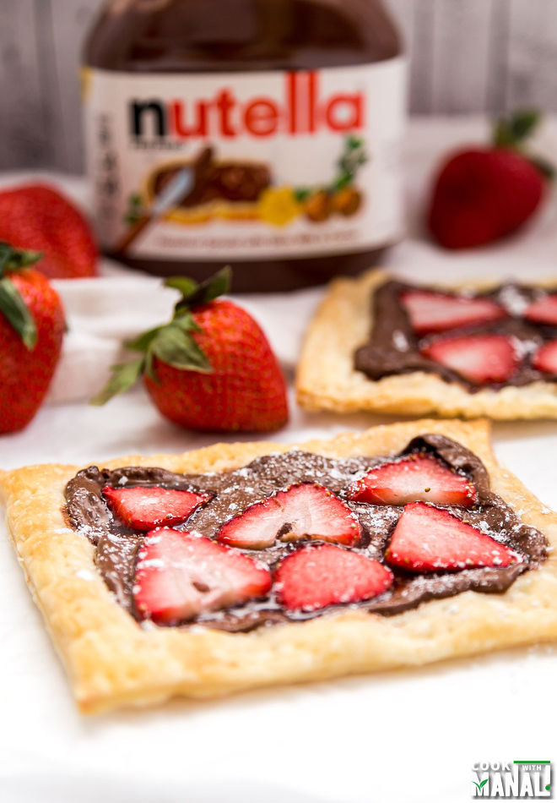
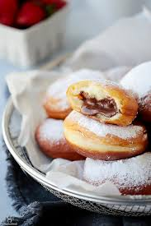
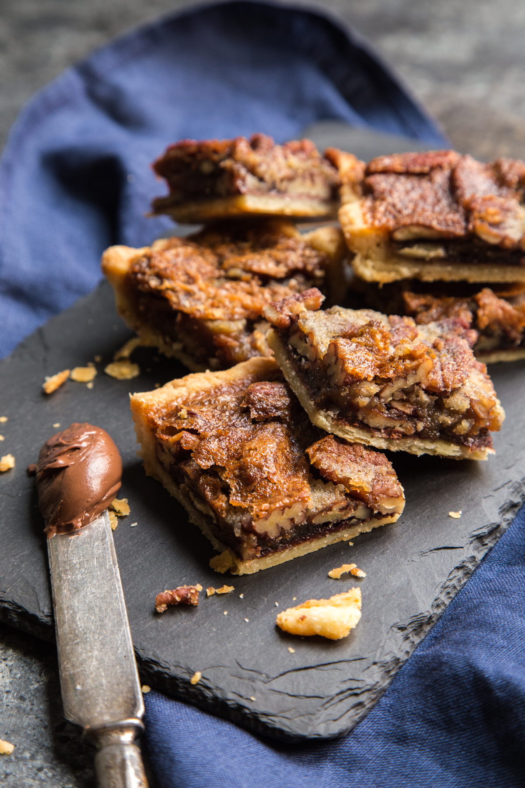

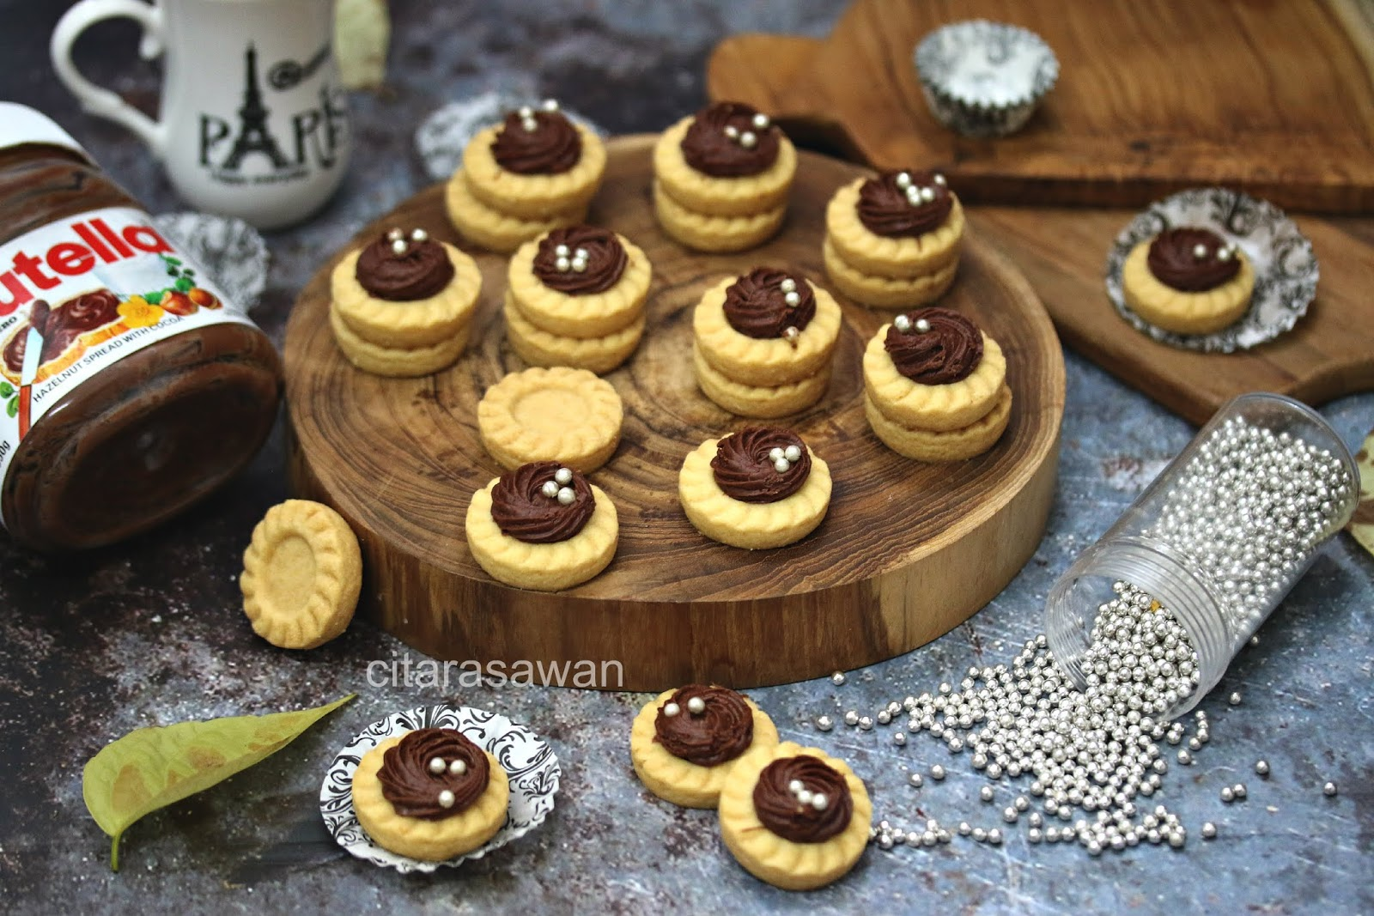
Advertising Objective
Push the boundaries of being just a spread for bread and show that Nutella is a very versatile snack that is a fun way to make.

